Slide 1
Housing Data File
DATA ANALYTICS 1 - 5130
FINAL TERM PROJECT - SPRING 2022
PROFESSOR - DENISE R. PHILPOT, PhD
Manisha Adulla
11525405

Slide 2
Research Questions
ANOVA Analysis 1:
Are mean Sales Prices for houses with and without Central Air same?
ANOVA Analysis 2:
Are mean Sales Prices for different house styles same?
Regression Analysis:
How to predict the Sales price?

Slide 3
Understanding the Dataset and perform EDA

Slide 4
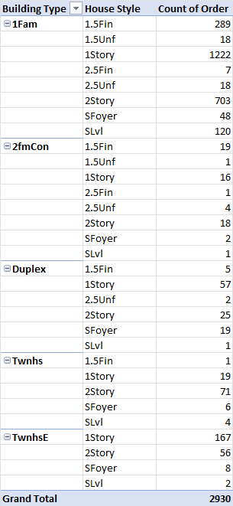

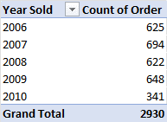
Pivot Table 1
Pivot Tables
Pivot Tables are created based on the categorical variables using the cleaned dataset.
Pivot Table 1 represents count of Houses based on Year Sold.
Pivot Table 2 represents count of Houses based on Building Type and House Style.
Pivot Table 3 represents count of Houses based on Central Air
Pivot Table 3
Pivot Table 2

Slide 5
Data Visualizations

Slide 6
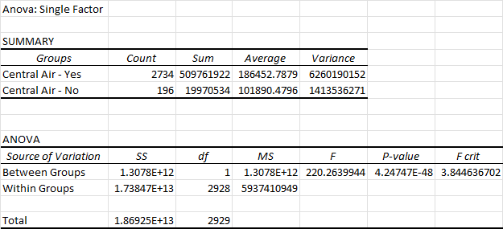
ANOVA Analysis 1
Research Question 1
Null Hypothesis - mean Sales Prices for houses with and without Central Air are same.
Alternate Hypothesis - mean Sales Prices for houses with and without Central Air are not same.
There is significance difference in the average sale price with respect to the categorical column ‘Central Air’. It is observed that the average sale price when the ‘Central Air’ being Yes is almost double compared to the ‘Central Air’ being No. Considering the performed ANOVA analysis, the p-static value is lesser than 0.05. So, we reject the Null hypothesis.

Slide 7
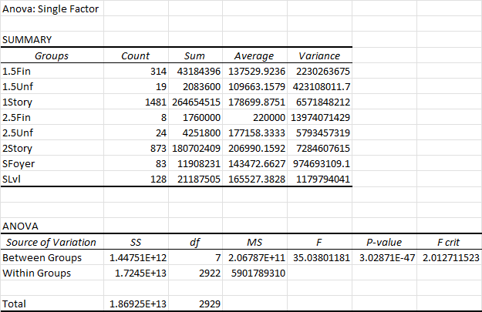
ANOVA Analysis 2
Null Hypothesis - mean Sales Prices for different house styles are same.
Alternate Hypothesis - mean Sales Prices for different house styles are not same.
Considering the performed ANOVA analysis, the p-static value is lesser than 0.05 and F value is greater than F critical value. So, we reject the Null hypothesis.

Slide 8
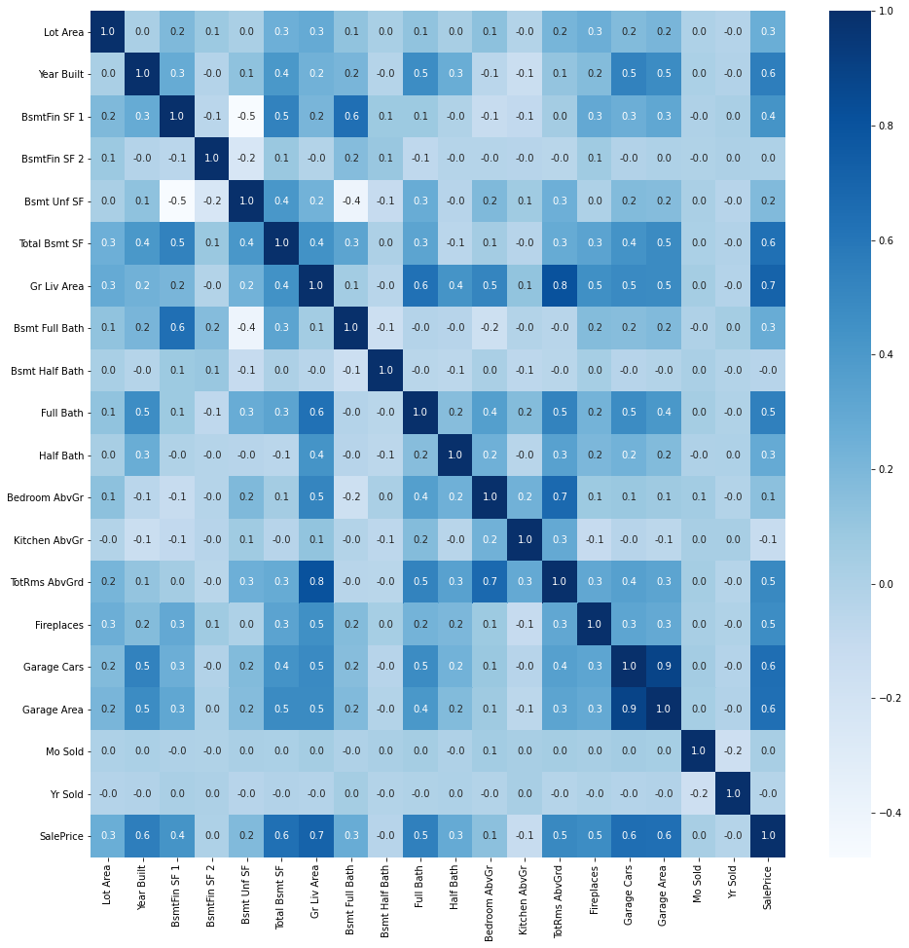
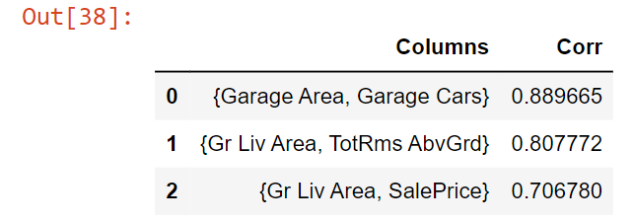
Correlation Matrix
Research Question 2
In the given dataset, the columns {Garage Area, Garage Cars} are highly correlated with a correlation coefficient of about 0.889 followed by the columns {Gr Liv Area, TotRms AbvGrd}, {Gr Liv Area, SalePrice} with correlation coefficient values 0.807772 and 0.706780 respectively.

Slide 9
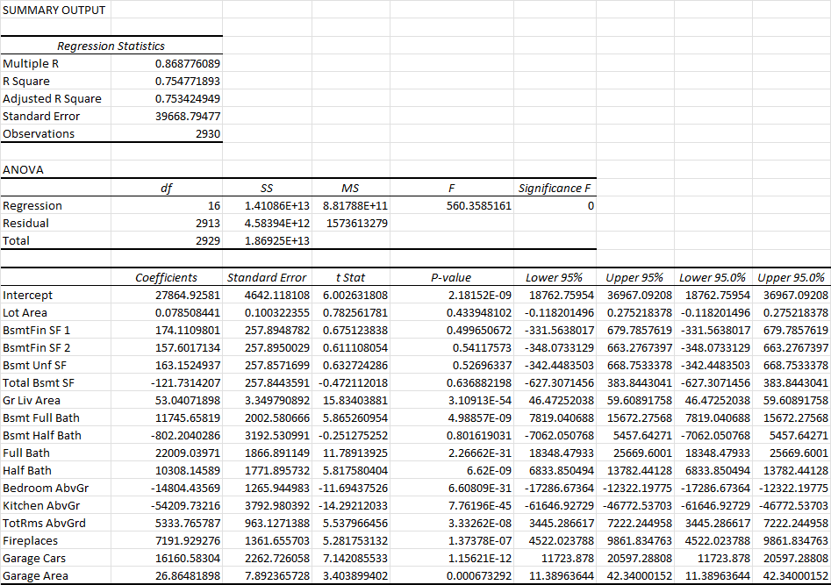
Regression Analysis
The R Square for the performed Regression model is 0.7547, which can be interpreted as the model explains 75.47% variability of the sales price when predicted with 16 independent variables. The R Square value ranges from 0 to 1 and closer the value to 1 better the model.
The Regression Equation is:
Y = 27864.93 + (Lot Area*0.08) + (BsmtFin SF 1*174.11O) + (BsmtFin SF 2*157.60) + (Bsmt Unf SF*163.15) + (Total Bsmt SF*-121.73) + (Gr Liv Area*53.04) + (Bsmt Full Bath*11745.66) + (Bsmt Half Bath*-802.20) + (Full Bath*22009.04) + (Half Bath*10308.15) + (Bedroom AbvGr*-14804.44) + (Kitchen AbvGr*-54209.73) * (TotRms AbvGrd*5333.77) + (Fireplaces*7191.93) + (Garage Cars*16160.58) + (Garage Area*26.86)

Slide 10
Conclusion
The imported Housing Data file is preprocessed, and various Exploratory Data Analysis (EDA) techniques are performed.
The implemented ANOVA Analysis 1 on the Sale price against the categorical variable Central Air depicted the significant change in variance and the p-value obtained is less than 0.05. Hence the Null hypothesis is rejected.
The performed ANOVA Analysis 2 on the Sale price against the categorical variable House Style with the p-value less than 0.05 rejecting the Null hypothesis.
The major limitation of ANOVA is that multivariate grouping analysis is time consuming and losing the variable level interpretation.
The designed Linear Regression model obtained the R Square value of 75.47% which is a good fit.
One limitation with the R Square evaluation is that it is not the only metric to interpret the performance of the model.

